Slide 1
Tackling Tobacco: Mental Health and Other Addictions
CADCA Mid Year Training
Margaret Meriwether, PhD
Behavioral Health and Wellness Director
Smoking Cessation Leadership Center
University of California San Francisco

Slide 2
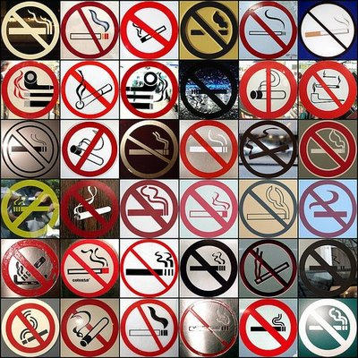
Today’s Topics
Mental Health, Addiction and Tobacco Treatment
Cessation Resources

Slide 3
COMPARATIVE CAUSES of ANNUAL DEATHS in the UNITED STATES
Individuals with mental illness or substance use disorders
Number of Deaths (thousands)
AIDS Obesity Alcohol Motor Homicide Drug Suicide Smoking
Vehicle Induced
Source: CDC
Notes:
Tobacco is the leading preventable cause of death in the US accounting for 440,000 deaths each year, more than AIDS, obesity, alcohol, motor vehicle accidents, homicide, drug induced and suicides, all combined. Based on the Lasser et al., 2000 study, 40.6% of smokers have current mental illness. If 440,000 deaths annually due to smoking, an estimated 178,640 are among individuals with current mental illness.
Lasser K, Boyd JW, Woolhandler S, Himmelstein DU, McCormick D, Bor DH. Smoking and mental illness: A population-based prevalence study. JAMA. Nov 22-29 2000;284(20):2606-2610.

Slide 4
Background
44% of cigarettes smoked in the US are consumed by individuals with mental health or substance use disorders
People with mental health disorders die on average 25 years earlier
21% of psychiatric hospitals still allow smoking inside their facilities
Notes:
This population consumes 44% of all cigarettes sold in the US
-- higher prevalence
-- smoke more
-- more likely to smoke down to the butt

Slide 5
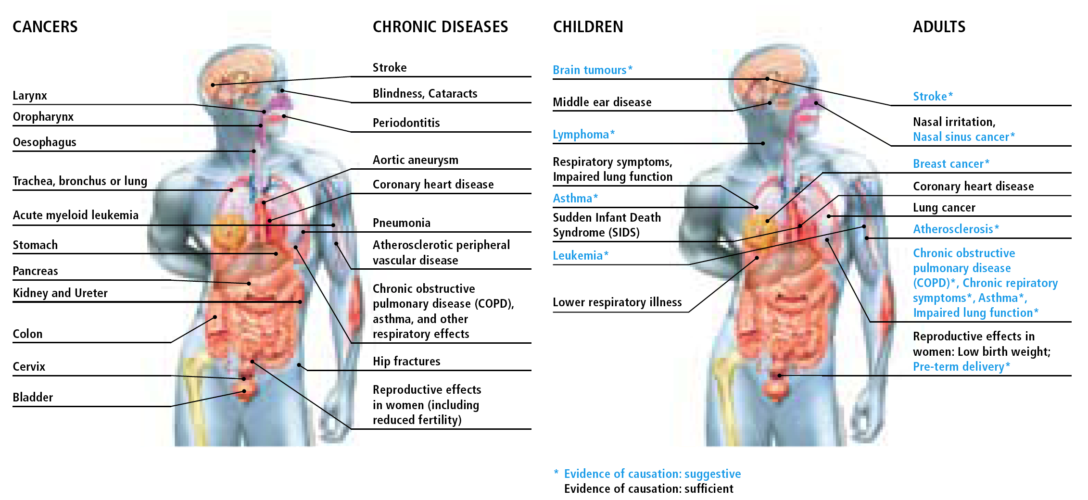
Tobacco Use Damages Virtually
Every Part of the Body
Smoking
Secondhand Smoke
Notes:
5

Slide 6
FINANCIAL IMPACT of SMOKING:
COSTS to the INDIVIDUAL
Buying cigarettes every day for 50 years @ $4.32 per pack
Money banked monthly, earning 4% interest
$755,177
$755,177
$503,451
$503,451
Packs
per
day
Even if you don’t invest the money, you will save
$1503.80/yr for each pack a day smoked
$251,725
$251,725
Dollars lost, in thousands
Notes:
6
6
In addition to the many health benefits of quitting, there are financial benefits of quitting too. The financial costs of tobacco use can be substantial to an individual person who smokes and their family, particularly when costs are added up over a lifetime. Overall, people can save a lot of money by quitting.
In one study, people with schizophrenia who smoked spent $140, on average, for cigarettes each month. This was about 27–36% of their total income for people on Social Security Disability Insurance (SSDI). Some people skip meals or do not pay their bills in order to pay for cigarettes (Steinberg et al., 2004). Thus quitting smoking can greatly improve qualify of life for people who smoke.
What people who buy 1, 2, or 3 packs of cigarettes a day every day for 50 years at $4.12 per pack will have if they instead bank their cigarette money each month:¹
1 pack a day: $110,489
2 packs a day: $220,978
3 packs a day: $331,467
Even if you don’t invest the money, the savings from not smoking is more than $1,500 a year for a person who smokes a pack a day.
¹Assume that the price per pack is constant, an annual interest rate of 1.5% (not adjusted for inflation), and that the money was banked monthly. Savings calculator tool available at www.calculatorweb.com.
Steinberg ML, Williams JM, Ziedonis DM. (2004). Financial implications of cigarette smoking among individuals with schizophrenia. Tobacco Control 13:206.

Slide 7
WHY do INDIVIDUALS with MENTAL Health Disorders SMOKE?
Smoking in adolescence is associated with psychiatric disorders in adulthood, including: panic disorder, GAD and agoraphobia, depression and suicidal behavior, substance use disorders, and schizophrenia (Breslau et al., 2004; Weiser et al., 2004; Goodman, 2000; Johnson et al., 2000)
MENTAL ILLNESS
SMOKING
Active psychiatric disorders are associated with daily smoking and progression to nicotine dependence (Breslau et al., 2004).
Notes:
The relationship between smoking and mental illness is complicated. While the onset of tobacco use typically precedes the development of mental illness, a causal association has not been established. Studies often control for potential confounding variables but there remains the possibility of third variables influencing both smoking and mental illness.
The prospective study by Breslau et al. (2004) concluded, “daily smoking might be a causal factor in panic disorder and agoraphobia, conditions that might be preventable by smoking cessation. Additionally, current smoking might serve as a marker for targeting interventions to prevent alcohol and drug disorders.”
The prospective study by Weiser et al. (2004) which followed 14,248 male Israeli military recruits over a 4 to 16 year follow-up found “smokers were at greater risk for later schizophrenia; the adjusted relative risk was 1.94, 95% confidence interval (CI) was 1.05-3.58. The number of cigarettes smoked was significantly associated with the risk for schizophrenia. Compared to nonsmokers, adolescents who smoked 1-9 cigarettes/day were 1.38 times (95% CI=0.48-4.00) as likely to be hospitalized later for schizophrenia, and adolescents who smoked 10 cigarettes/day or more were 2.28 times (95% CI=1.19-4.34) as likely; the latter difference was statistically significant.”
In their analysis of prospective data from the National Longitudinal Study of Adolescent Health, Goodman & Capitman (2000) concluded “in contrast to common dictum, depression does not seem to be an antecedent to heavy cigarette use among teens. However, current cigarette use is a powerful determinant of developing high depressive symptoms.” Their analyses found “For the nondepressed, multivariate modeling revealed that current cigarette smoking was the strongest predictor of developing high depressive symptoms in all models (final model odds ratio [OR]: 3.90; 95% confidence interval [CI]: 1.85,8.20).”
In analysis of their 4-year prospective data, Johnson et al. (2000) concluded “Our results suggest that cigarette smoking may increase risk of certain anxiety disorders during late adolescence and early adulthood.” Their findings were as follows: “Heavy cigarette smoking (>/=20 cigarettes/d) during adolescence was associated with higher risk of agoraphobia (10.3% vs 1.8%; odds ratio [OR], 6.79; 95% confidence interval [CI], 1.53-30.17), generalized anxiety disorder (20.5% vs 3.71%; OR, 5.53; 95% CI, 1.84-16.66), and panic disorder (7.7% vs 0.6%; OR, 15.58; 95% CI, 2.31-105.14) during early adulthood after controlling for age, sex, difficult childhood temperament; alcohol and drug use, anxiety, and depressive disorders during adolescence; and parental smoking, educational level, and psychopathology. Anxiety disorders during adolescence were not significantly associated with chronic cigarette smoking during early adulthood.”
Breslau N, Novak SP, Kessler RC. Daily smoking and the subsequent onset of psychiatric disorders. Psychol Med;34(2):323-33
Weiser M, Reichenberg A, Grotto I, Yasvitzky R, Rabinowitz J, Lubin G, Nahon D, Knobler HY, Davidson M. 2004. Higher rates of cigarette smoking in male adolescents before the onset of schizophrenia: a historical-prospective cohort study. Am J Psychiatry;161(7):1219-23.
Goodman & Capitman, 2000. Depressive symptoms and cigarette smoking among teens. Pediatrics;106(4):748-55.
Johnson et al., 2000. Association between cigarette smoking and anxiety disorders during adolescence and early adulthood. JAMA; 284(18):2348-51

Slide 8
Smoking Prevalence by
Mental Health Diagnosis
Current smoking
  1 mental health diagnosis 32%
  2 mental health diagnoses 42%
  3+ mental health diagnoses 61%
2007 National Health Interview Survey Data
  Schizophrenia 59%
  Bipolar disorder 46%
  ADD/ADHD 37%
8

Slide 9
SMOKING RATE by Mental Health History
41.0% Overall
Active
National Comorbidity Survey 1991-1992
Source: Lasser et al., 2000 JAMA
Notes:
While the prevalence of cigarette smoking among US adults has steadily declined since the first Surgeon General’s report on smoking and health in 1964, rates remain elevated among psychiatric populations. The smoking prevalence among individuals with a current psychiatric illness is nearly double that of individuals without mental illness (41% vs. 23%) and even higher among the seriously mentally ill and those with comorbid substance abuse problems.
Lasser K, Boyd JW, Woolhandler S, Himmelstein DU, McCormick D, Bor DH. Smoking and mental illness: A population-based prevalence study. JAMA. Nov 22-29 2000;284(20):2606-2610.
Data from the National Comorbidity Survey, 1991-1992
Nationally-representative sample N=4411, aged 15 to 54 years old
Structured clinical interviews used to establish DSM-IV criteria for current or past mental illness. Current defined as past month. Disorders assessed were anxiety disorders, mood disorders, nonaffective psychosis, ASPD, conduct disorder, and alcohol and drug abuse/dependence.
** Note: The rates of tobacco use by psychiatric diagnostic category vary in the literature by the type of populations sampled. This study was a national population sample.

Slide 10
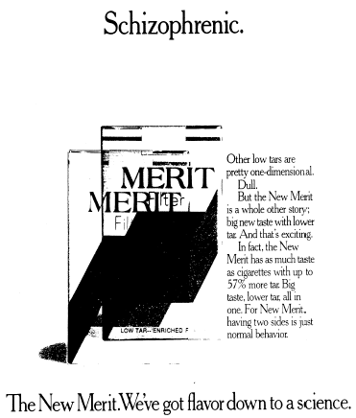
Source: Legacy Tobacco Documents
Notes:
A 1986 advertisement for Philip Morris’ Merit cigarettes suggests evidence of direct marketing of tobacco products to individuals with schizophrenia. The ad shows a double image of a pack of Merit cigarettes and reads, “Schizophrenic…For New Merit, having two sides is just normal behavior.”
Prochaska, J.J., Hall, S.M., & Bero, L. (2008). Tobacco use among individuals with schizophrenia: what role has the tobacco industry played? Schizophrenia Bulletin, 34, 555-567.

Slide 11

Indoor Smoking Room

Slide 12
National Research Institute
*Response rates: 2005 – 55%, 2006 – 82%, 2008 – 75%, 2011 – 80%
Source: Schacht L, Ortiz G, Lane M. Smoking Policies and Practices in State Psychiatric Hospitals 2011. National Association of State Mental Health Program Directors Research Institute, Inc. Feb 29, 2012.
Notes:
There were 165 surveys returned from 44 states, territories and the District of Columbia, representing 80% of state psychiatric facilities in 2011. The majority of respondents were facility directors, though, quality managers tended to be respondents on follow-up requests.
Facility population was classified along two dimensions: age and service level. Respondents selected from a list of 8 different possibilities representing different populations and settings: children, under 12 years of age (acute and/or long-term), youth 12-18 years (acute and/or long-term); adult (acute and/or long-term); geriatric; forensic; and other. For purposes of analysis, children and youth were combined. (No facility served only youth). 75% of facilities serve adult, 55% serve forensic, and 24% serve geriatric 17% of facilities that serve adults also serve children/youth More facilities provide acute care (66%) than long-term care (46%) for adult populations.
Facility size ranged from 16 to 1,527 beds. Forty-three percent (43%) of facilities have less than 150 beds, 36% have 150-299 beds, and 21% have 300 or more beds.
Findings
Utilizing NRI’s operational definitions, 79% of the facilities were categorized as prohibiting smoking (n=131), the vast majority of which (95%) are totally smoke-free campuses. For those facilities categorized as allowing smoking (n=34), 3% allow smoking inside the facility in designated smoking areas, 24% allow smoking outdoors, and 74% allow smoking outdoors only in designated areas. Three percent (3%) of the facilities that prohibit smoking and 41% of facilities that allow smoking also allow the use of smokeless tobacco products. None of the facilities that prohibit smoking and 21% of facilities that allow smoking also permits the sale of tobacco products on facility premises.
Among facilities that allow smoking, 50% use escorts to smoking areas (n=17) and 88% of these facilities also have established smoking times, while the remaining facilities rely on patient privileges and designated smoking areas.

Slide 13
Medications Affected by Smoking
Brand Name Generic Name
Elavil Amitriptyline
Anafranil Clomipramine
Aventyl/Pamelor Nortiptyline
Tofranil Imipramine
Luvox Fluvoxamine
Thorazine Chlorpromazine
Prolixin Fluphenazine
Haldol Haloperidol
Clorizaril Clozapine
Zyprexa Olanzapine
Tylenol Acetaminophen
Inderal Propanolol
Slo-bid, Slo-Phyllin, Theophylline
Theo-24, Theo-Dur,
Theobid, Theovent
Caffeine

Slide 14
WHY ADDRESS TOBACCO USE in Behavioral Health?
Prevent Death
Improve Health
Optimize Psychiatric Medication Effects
Reduce Isolation
Patient $ Savings
Tobacco Industry Profits
Interest groups/politicians supported by Tobacco Industry
Tax revenues
Notes:
There are a variety of reasons for addressing tobacco use in the mentally ill including reducing morbidity and mortality, maximizing mental health treatment efficacy, reducing patient isolation, and reducing costs to patients and society.
Efforts that have hindered progress include work by the tobacco industry to maintain beliefs that the mentally ill need to smoke to manage their psychiatric symptoms. The tobacco industry also works through financial support provided to interest groups and politicians.
While tax revenues may seem like a positive outcome from tobacco use for governments, in the end the health costs and loss productivity costs result in far greater costs to society than any gain in tax revenue.

Slide 15
Mental Health Key Messages
    25 year mortality gap due largely to smoking
    Smokers with schizophrenia spend >1/4 income on cigarettes
    Tobacco use interferes with psychiatric medications
    Although more than 2/3 of smokers want to quit only 3% able to quit on their own-need help
    Highly addicted smokers with mental illness can quit and more likely to succeed with medications and behavioral therapy

Slide 16
WHAT is ADDICTION?
“Compulsive drug use, without medical purpose, in the face of negative consequences”
Alan I. Leshner, Ph.D.
Former Director, National Institute on Drug Abuse
National Institutes of Health
Notes:
Many people believe that addiction is a result of weakness in character and an inability to change one’s behavior. But is it really that simple? Research contradicts this position. Nicotine addiction is a form of chronic brain disease resulting from an alteration in brain chemistry (Leshner, 1997, 1999). Dr. Alan Leshner, the former director of the National Institute on Drug Abuse, simply defines drug addiction as “compulsive use, without medical purpose, in the face of negative consequences” (Leshner, 1997).
Leshner Al. Drug abuse and addiction are biomedical problems. Hosp Pract (special report) April 1997:2–4.
Leshner AI. Science-based views of drug addiction and its treatment. JAMA 1999;282: 1314­1316.

Slide 17
Nicotine a Gateway Drug
Kandel showed nicotine addiction can cause cocaine addiction in rats, but not vice versa
Implications 2-fold:
1. Nicotine a gateway drug for cocaine; exposure to it enhances subsequent pleasure from cocaine
2. Thus, giving NRT to cocaine users may exacerbate cocaine dependency
Source: A. Levine, Y. Huang, B. Drisaldi, E. A. Griffin, D. D. Pollak, S. Xu, D. Yin, C. Schaffran, D. B. Kandel, E. R. Kandel. Molecular Mechanism for a Gateway Drug: Epigenetic Changes Initiated by Nicotine Prime Gene Expression by Cocaine. Science Translational Medicine, 2011; 3 (107)
Notes:
SURVEY—how many of you have cocaine related problems in your community?
Connection with cocaine addiction
Reputable, high profile journal and prominent editorialist (Volkow of NIDA) and researchers (Kandel is a nobel laureate). Study by Kandel shows nicotine addiction is a cause of cocaine addiction in mice but not vice versa. This lead to Nora's editorial "Another Nail in the Coughing”

Slide 18
Smoking, Drug and Alcohol Use in 2007
 | Smokers | Non Smokers
Current Illicit Drug Use Past month | 20.1% | 4.1%
Alcohol Use Past month | 66.9% | 46.1%
Binge Drinking Past month | 45% | 16.4%
Heavy Drinking Past month | 16.4% | 3.8%
Adults in this survey are age 12+
Substance Abuse and Mental Health Services Administration, Office of Applied Studies (2008). Results from the 2007 National Survey on Drug Use and Health: National Findings (NSDUH Series H-34, DHHS Publication No. SMA 08-4343). Rockville, MD.
Notes:
Use of illicit drugs and alcohol was more common among current cigarette smokers than among nonsmokers in 2007, as in 2002 through 2006
Past month alcohol use was reported by 66.9% of current cigarette smokers compared with 46.1% of those who did not use cigarettes in the past month.
All statistics in this slide refer to adults as age 12 and older!
Smokers and nonsmokers refers to current cigarette users and current cigarette non users—past 30 days

Slide 19
Nicotine and other Addictions
Nationally 77-93% of people in addiction treatment settings use tobacco, more than triple the national average
Source: Richter et al., 2001
Tobacco use may increase the pleasure experienced when drinking alcohol
Source: US DHHS NIDA Alcohol Alert, 2007
Heavy smoking may contribute to increased use of cocaine and heroin
Source: US DHHS NIDA Notes, 2000
Heavy smokers have other, more severe addictions than non-smokers and moderate smokers
Source: Marks et al., 1997; Krejci, Steinberg, and Ziedonis; 2003
Notes:
Doug Z’s statistics—on mouth cancer. Credit Doug

Slide 20
Tobacco and
Addiction Treatment
Co-founders of AA, Dr. Bob and Bill W., died of tobacco related diseases
Most states exempt addiction treatment settings when regulating smoking in the workplace
Unintended consequences of SA Treatment:
    Usually if a person has not started smoking by age 20, it’s unlikely that they will ever smoke. But a significant number of adult substance abusers start smoking in treatment (Friend & Pagano, 2004)

Slide 21
Key Messages in SA
High association between smoking, illicit drug use, and alcohol use
Tobacco is a gateway drug
Nearly 50% of people in recovery will die from tobacco-related diseases (Hughes et al, 2000; Hurt et al., 1996)
Notes:
Focuses primarily on adults with substance abuse issues
Most slides depict data from SAMHSA National Survey on Drug Use and Health (NSDUH) or from National Estimates of Expenditures for Mental Health Services and Substance Abuse Treatment, 1991 – 2001. SAMHSA: 2005.
The National Survey on Drug Use and Health (NSDUH) obtains information on nine different categories of illicit drug use: use of marijuana, cocaine, heroin, hallucinogens, and inhalants; and the nonmedical use of prescription-type pain relievers, tranquilizers, stimulants, and sedatives. In these categories, hashish is included with marijuana, and crack is considered a form of cocaine.
Several drugs are grouped under the hallucinogens category, including LSD, PCP, peyote, mescaline, psilocybin mushrooms, and "Ecstasy" (MDMA).
Inhalants include a variety of substances, such as nitrous oxide, amyl nitrite, cleaning fluids, gasoline, spray paint, other aerosol sprays, and glue.
The four categories of prescription-type drugs (pain relievers, tranquilizers, stimulants, and sedatives) cover numerous medications available by prescription and drugs within these groupings that may be manufactured illegally, such as methamphetamine, which is included under stimulants. Respondents are asked to report only "nonmedical" use of these drugs, defined as use without a prescription of the individual's own or simply for the experience or feeling the drugs caused. Use of over-the-counter drugs and legitimate use of prescription drugs are not included. NSDUH reports combine the four prescription-type drug groups into a category referred to as "psychotherapeutics."

Slide 22
Promoting Cessation
Talking points
Challenges
Resources

Slide 23
TALK to COMMUNITY PROFESSIONALS about the IMPORTANCE of SMOKING CESSATION
Get buy-in from providers and administrators
  “We need support from those who lead us.”
  Discuss health and cost benefits
Promote tobacco-free environments
  Policies support an environment for quitting
Encourage the development of support groups for smoking cessation
Notes:
23
It may be important to talk with program staff about the importance of smoking cessation. As we have mentioned before, for a long time, smoking has not been properly addressed among people with mental illnesses, and it is possible that staff are continuing to ignore tobacco use among their clients.
In many cases, it will be important to get the support from providers and administrators when working on smoking cessation. You can make providers and administrators aware of the high rates of smoking among people with mental illnesses and the health, cost, and social and psychological benefits to quitting.
You can use your knowledge and experiences to promote tobacco-free facilities and campuses. The National Association of State Mental Health Program Directors’ “Tobacco-Free Living in Psychiatric Settings: A Best Practices Toolkit Promoting Wellness and Recovery” can provide you with helpful strategies in working to make facilities and campuses smoke free (NASMHPD, 2007). Furthermore, you can encourage the development of support groups around smoking cessation for consumers. By having people share their successes and struggles with smoking cessation, individuals can realize that they are not alone in dealing with these issues.
National Association of State Mental Health Program Directors (NASMHPD). (2007). Tobacco-Free Living in Psychiatric Settings: A Best Practices Toolkit Promoting Wellness and Recovery. Alexandria, VA.

Slide 24
ADVICE IMPROVES CHANCES of QUITTING
Compared to people who smoke who do not get help from a clinician, those who get help are 1.7–2.2 times as likely to successfully quit for 5 or more months.
n = 29 studies
2.2
1.7
1.0
1.1
Fiore et al. (2008). Treating Tobacco Use and Dependence: 2008 Update.
Rockville, MD: USDHHS, PHS.
Notes:
24
Clinicians, such as mental health providers and doctors, have been shown to play an important role in helping people quit. A look at 29 studies showed that people who talk about smoking cessation with a person who is a clinician but not a doctor (like many mental health providers) are 1.7 times as likely to quit compared to people who do not talk about smoking cessation with a clinician. People who talk with a doctor about quitting are more than twice as likely to quit as compared to people who do not talk with a doctor (Fiore et al., 2008).
All healthcare professionals, including peer counselors, can play a role in helping a person quit. It is important to ask all your peers whether they smoke. You might be the one person that a particular consumer will pay attention to. You can help to save a life.
Fiore MC et al. (2008). Treating Tobacco Use and Dependence: 2008 Update. Rockville, MD: U.S. Department of Health and Human Services, Public Health Service.

Slide 25
STARTING the CONVERSATION
Starting to talk to a peer about their smoking is not always easy
Remember that people have different feelings about their smoking; some people may want to quit, others may not
How do you start the conversation? A suggestion:
  “I want to support you in improving your mental and physical health, and tobacco use can hurt both our physical and our mental health. People who get help are more likely to be successful in quitting smoking. Do you smoke? If yes, do you want to quit? If you want to quit, I want to support you in the process of becoming smokefree. If you are not ready to quit, is it okay if I ask you again sometime in the future about your smoking? “
Notes:
25
Starting a conversation with a peer about smoking may be difficult at first. We would like you to practice with a partner starting to talk about tobacco use Once you practice this opening piece, then we will move on to some Dos and Don’ts and then practicing AAR and the 5A’s.

Slide 26
CHALLENGES of QUITTING
People smoke in many situations:
Quitting requires coping – changing thoughts and behaviors– in these situations
Quitting requires motivation – a more positive life outlook and other meaningful reasons to quit
Talking with someone who knows about quitting can help smokers cope and get motivated to quit
When drinking coffee
While driving in the car
When bored
While stressed
While at a bar
After meals
During breaks at work
While on the phone
When with family or friends who smoke
While drinking or using drugs
Notes:
26
What behaviors might need to change? The average smoker takes about ten puffs on a cigarette and smokes about 20 to 30 cigarettes a day. Therefore, they puff on a cigarette, on average, 200 to 300 times a day. People who smoke spend about 2 hours a day smoking. Your peers will need help figuring out what they should do during times when they would be smoking when they have quit.
Smoking becomes linked to certain behaviors, situations, and moods. For many people who smoke, certain situations like driving the car can make them want a cigarette. Many people who smoke, for example, light up right after they finish a meal without thinking about it. Or they go out with friends and start smoking after they have had a few drinks. People who smoke sometimes have habits that link many of the things they do during their day to smoking. Thus, people may find that they relapse or go back to smoking, when they re in one of these situations when they tend to smoke. Relapse is common but quitting is definitely possible. Unfortunately, smoking cessation medications like NRT will not help with these “behavioral” aspects of smoking.
Instead, to quit smoking, people need to break these links. They need to be able to drink coffee without smoking. They need to learn to do other things during their breaks from work or while on the telephone. Counseling can help people to learn how to deal with these situations without having a cigarette and how to change behaviors and routines. Part of quitting is learning to do something else other than smoking during these situations. For example, a person might get up after a meal and brush his teeth. In stressful times, she might do some deep breathing and picture herself on a beach. When out with friends they could go to a location where smoking is not allowed. In all cases, the new behaviors are not connected to smoking, so the person who is trying to quit does not start thinking about a cigarette.
Quitting requires changing how you think, as well as what you do, to cope with the situations listed on this slide. Talking with someone who knows about quitting can help people learn to cope without having a cigarette or using tobacco.

Slide 27
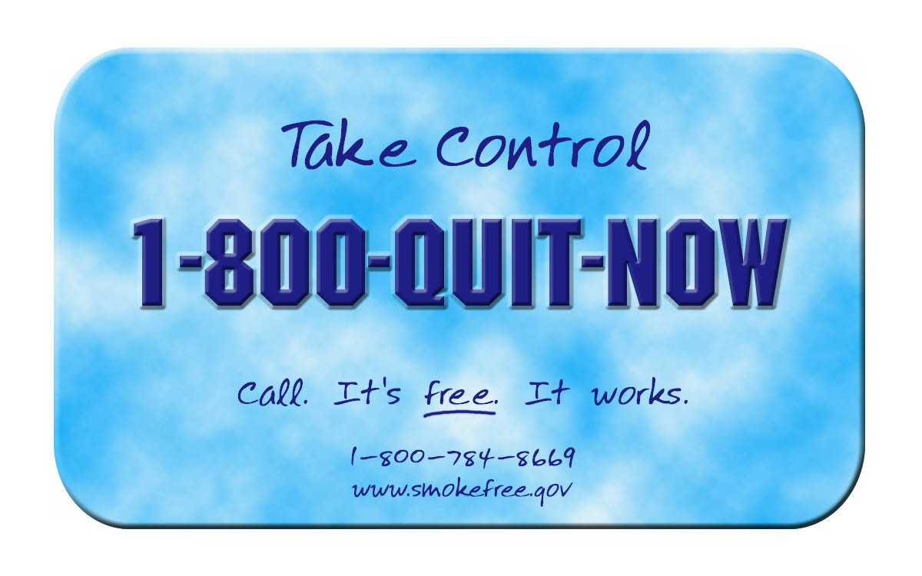
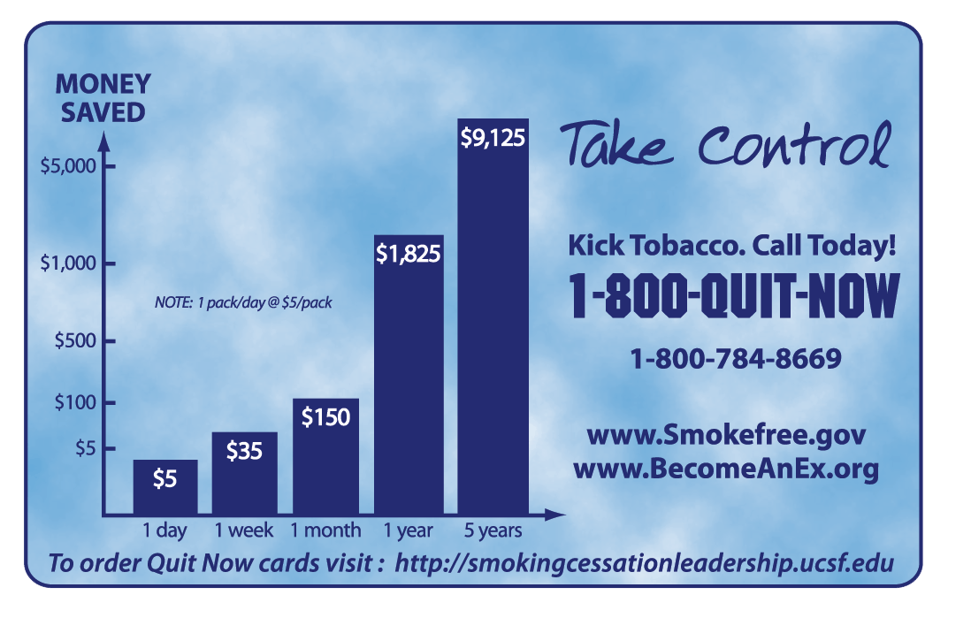
Why the Focus on Quitlines?
They work--calling a quitline can more than double the chance of successfully quitting
Many people unaware of quitlines; when they learn about them they are willing to refer smokers to them

Slide 28
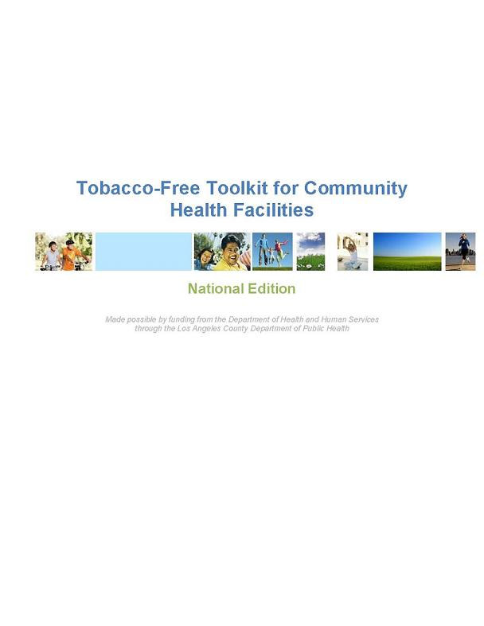
New Cessation Resources
Spanish version of Rx for Change
National Toolkit from SCLC –develop and implement policy
Free

Slide 29
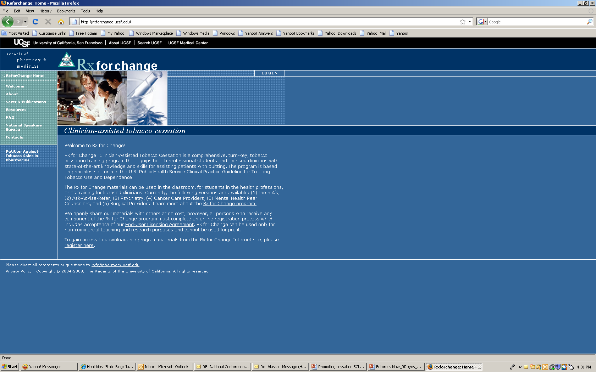

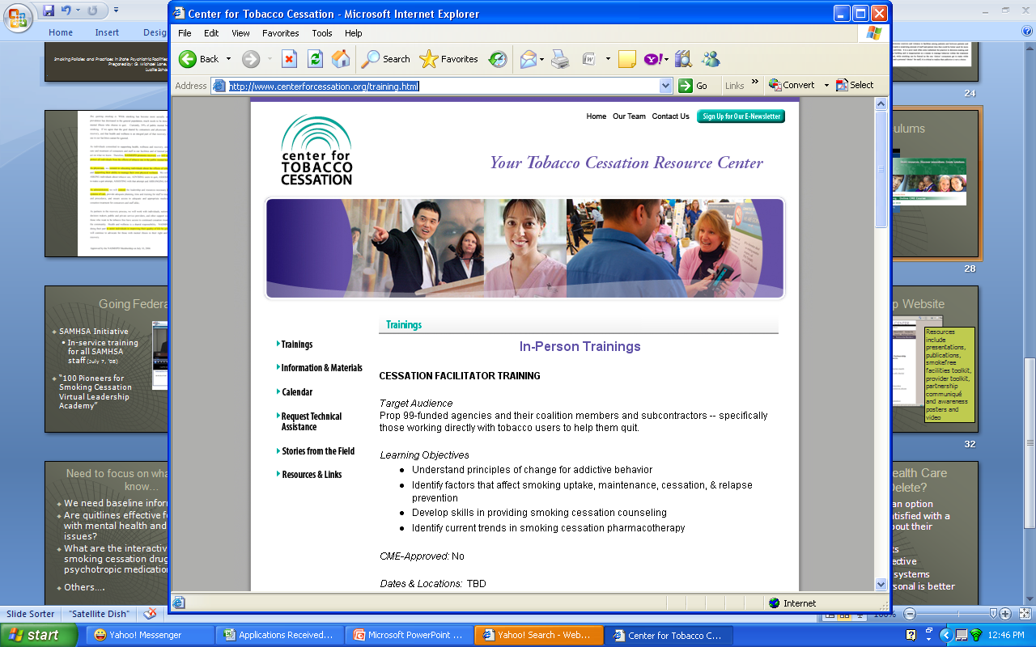
New Curricula
Notes:
Rx for Change: Clinician-Assisted Tobacco Cessation was designed to address an identified need to enhance the tobacco cessation education of health professionals.
from the Clinical Practice Guideline for Treating Tobacco Use and Dependence, is a comprehensive, turn-key program for training students and licensed clinicians in virtually any health professional field. Tobacco Cessation (“5 A’s” approach)
Our complete curriculum, including all core and optional modules, requires approximately 12 hours for implementation. These materials are applicable to any health profession. Our most common implementation scenario is 6 to 8 hours, which includes all core modules plus the Forms of Tobacco module. Slides are supplemented with ancillary handouts, role playing with case scenarios, and video segments.
Rx for Change: Ask-Advise-Refer (brief intervention)
Tailored versions are available for:
Psychiatry Rx for Change (coming soon)
The prevalence of smoking among patients with mental illness is 2 to 4 times that seen in the general population. Co-occurring mental illness or addictive disorders can present unique challenges when working with a patient to quit smoking. Dr. Jodi Prochaska and colleagues at the University of California, San Francisco have created a 4-hour curriculum that is specific to psychiatry and has shown very promising results in changing the knowledge, attitudes, confidence, and clinical practices of psychiatry residents for treating tobacco use and dependence in their patients.
Cancer care providers
Smoking impacts nearly every facet of cancer treatment: surgery, chemotherapy, and radiation. This 2-hour program targets cancer care providers, of all disciplines, in helping patients with cancer to quit smoking. Also available as a web-based CME/CE course.
Mental health peer counselors
This 2-hour program was created to equip peer counselors with the necessary knowledge and skills to assist mental health consumers with tobacco cessation. Created in collaboration with the National Mental Health Partnership for Wellness and Smoking Cessation.
Surgical care provider
University of Colorado at Denver Provider toolkit: resources for health care providers on intervening with persons with mental illnesses.
CHOICES is an exciting new consumer-driven program for smokers with mental illness in New Jersey. Our goal is to increase awareness of the importance of addressing tobacco use and to create a strong peer support network that encourages mental health consumers to make a positive healthy lifestyle change by addressing smoking and tobacco use.
CHOICES is innovative because it employs mental health consumers, called Consumer Tobacco Advocates, to deliver the vital message to smokers with mental illness that addressing tobacco is important and to motivate them to seek treatment. The Consumer Tobacco Advocates provide their peers with information about the consequences of smoking, issues regarding smoking and mental illness, and options available to make quitting easier. They visit mental health centers, self-help centers and health fairs to communicate with and educate consumers about their smoking.

Slide 30

Toolkits Tailored to Different Behavioral Health Populations

Slide 31
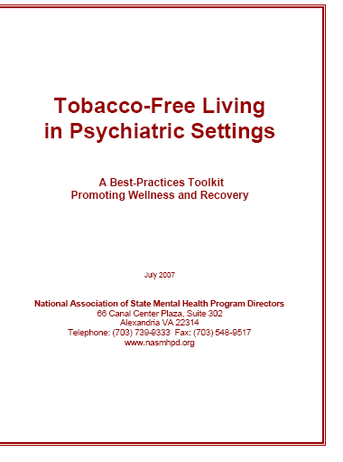

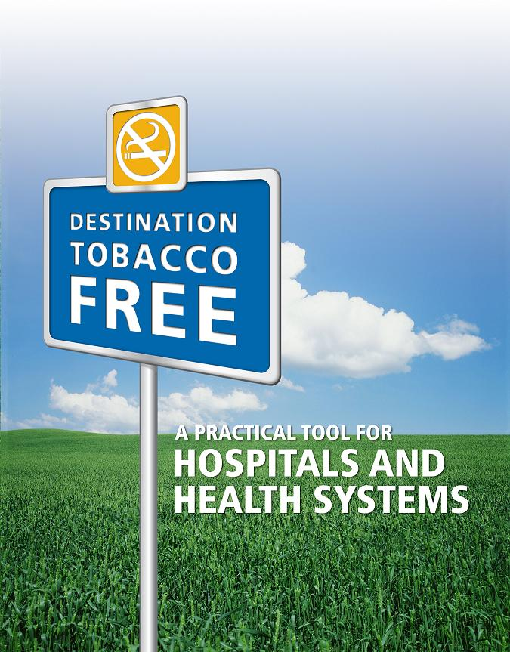
Free Toolkits
Notes:
Developed technical assistance tool kit addressing how to implement smoking cessation in psychiatric hospital settings
Featured smoking cessation as a plenary topic during its recent National Summit of State Psychiatric Hospital Superintendents
Promoted 1-800-QUIT NOW

Slide 32



Not new, but Improved Tools
Rx for Change, AAR version
Become an Ex
                Truth campaign
Notes:
Rx for Change is continually updated

Slide 33

Webinars
Most webinars available on our website http://smokingcessationleadership.ucsf.edu
CEUs available
28 and counting
Topics from Cessation 101 to Smoking and Schizophrenia
Renowned experts
Free

Slide 34

Online Network
100Pioneers@listsrv.ucsf.edu
Members include national behavioral health leaders, clinicians, researchers, consumers, tobacco experts
Post queries to a national audience
Free
Notes:
Moderated by sclc and option for weekly summary. Join our FB page

Slide 35
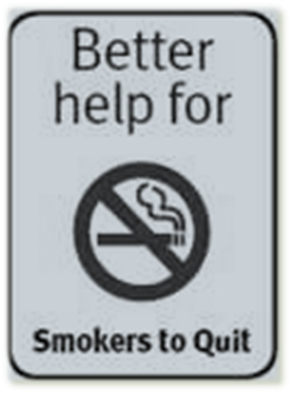
Power of Intervention
⅓ - ½ of the 44.5 million smokers will die from the habit
Increasing the 2.5% cessation rate to
  10% = 1.2 million lives saved
  15% = 1.9 million lives saved
No other health intervention could make such a difference!

